Slide 1
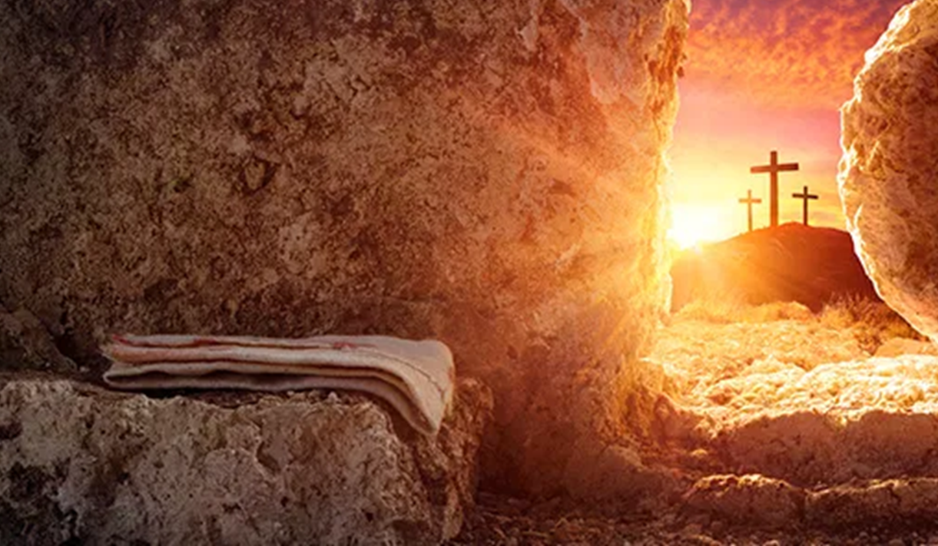
因祂活着
Because He Lives

Slide 2
神子耶穌，降生到世界，
醫治拯救世上罪人
God Sent His Son,
They Called Him Jesus;
He Came To Love,
Heal And Forgive.

Slide 3
為贖我罪主釘死十架，
空的墳墓
卻證明救主仍活著
He Lived And Died
To Buy My Pardon;
An Empty Grave Is There
To Prove My Savior Lives.

Slide 4
因祂活著，我能面對明天
因祂活著，不再懼怕
Because He lives,
I can face tomorrow.
Because He lives,
All fear is gone.

Slide 5
我深知道祂掌握明天，
生命充滿了希望，
只因祂活著。
Because I know
He holds the future,
And life is worth the living
just because He lives.

Slide 6
新生嬰孩，被抱在懷裡，
何等安祥令你欣喜；
How sweet to hold a newborn baby,
And feel the pride
and joy he gives.

Slide 7
但你確信這幼小生命，
卻能面對著明天
因救主活著
But greater still the calm assurance,
This child can face uncertain days
because He lives

Slide 8
因祂活著，我能面對明天
因祂活著，不再懼怕
Because He lives, I can face tomorrow.
Because He lives, All fear is gone.

Slide 9
我深知道祂掌握明天，
生命充滿了希望，
只因祂活著。
Because I know He holds the future,
And life is worth the living just because He lives.

Slide 10
當我走完，人生的路程，
面對死亡痛苦爭戰；
And then one day I'll cross the river,
I'll fight life's final war with pain.

Slide 11
救主為我戰勝了死權，
在榮光中我見救主
祂是活著
And then as death gives way to victory,
I'll see the lights of glory and I'll know He lives.

Slide 12
因祂活著，我能面對明天
因祂活著，不再懼怕
Because He lives, I can face tomorrow.
Because He lives, All fear is gone.

Slide 13
我深知道祂掌握明天，
生命充滿了希望，
只因祂活著。
Because I know He holds the future,
And life is worth the living just because He lives.

Slide 14
因祂活著，我能面對明天
因祂活著，不再懼怕
Because He lives, I can face tomorrow.
Because He lives, All fear is gone.

Slide 15
我深知道祂掌握明天，
生命充滿了希望，
只因祂活著。(2X)
Because I know He holds the future,
And life is worth the living just because He lives.

